Slide 1
Game of Life VIVA
Group Members: Zik Zhao, Zixuan Zhu, Chenxing Liu

Slide 2
Parallel: Evaluation Steps
Read file
Write file
IO
Repeat until completed or interrupted
Send request
Obtain later
Collect results
Handle/Send events
Send request
Check idle
Distributor
Running flag unset
Broadcast
Condition variable broadcast
Turn results send back
Wait on condition variable
Worker A
Wait after creation
GOL Logic
Wait
Worker B
Running
...

Slide 3
Parallel: Divide Matrix Into Blocks
We allocate works for each worker by dividing matrix into evenly sized blocks instead of strips.
This is implemented as the divideIntoBlocks function in distributor.go. This function returns a slice of an anonymous structure, which contains two positions as fields, one for the top-left corner of block and one for bottom-right corner (not inclusive) of block.
This function has a limitation that it does not accept prime number of threads, prime number will be floored to nearest composite number.

Slide 4
Parallel: Dispatch Tasks
All worker goroutines are created before the evaluation loop:
Status variables and synchronisation primitives are created.
Relevant information for each worker is stored in structure called WorkerParams.
Workers are created with said structures passed in.
Workers immediately acquires locker of condition variable, send an empty result to channel to notify the distributor that this worker is ready, and then wait on condition variable.
Distributor read the empty result from channel.

Slide 5
Parallel: Matrix Structure and Counts of Surrounding Alive Cells
We have a Matrix structure storing pixel values of the image, its width and height, and an extra 2D slice storing the counts of surrounding alive cells for every cell in the matrix.
The Matrix structure provides three methods:
getSurrounding is used to get the positions of eight surrounding cells for a specific cells.
checkAndFlip and checkAndFlipUnsafe are two functions transforming status of cells in different ways.
This surrounding count 2D slice is maintained during evaluation. Any flipping in cells causes the surrounding counts of its surrounding cells to change.
The introduction of surrounding counts reduces workload but produces data races.

Slide 6
Parallel: Solving Data Races
Data races are produced at the boundaries of blocks since the flipping of cells at boundaries need to update surrounding counts for surrounding cells that are living in other blocks.
Thus, we call different methods for different part of blocks:
Example: 8x8 grid, 4 threads
Green parts are safe regions
Because all its surrounding cells are in the same block
checkAndFlip
Will update surrounding counts immediately
Red parts are unsafe boundaries
Because at least one of its surrounding cells is not in the same block
checkAndFlipUnsafe
Will not update but record these cells

Slide 7
Parallel: Refactored IO
The refactored IO component provides two more functions for distributor: sendIoRequest and waitIoRequest.
The distributor can initiate an IO request by calling the former one and the IO component will complete that request in background. The distributor can then gather data or check idle later by calling waitIoRequest which blocks until last request is completed.
An IO request is represented by the ioOperation structure. It becomes a field of ioState. The condition variable in ioState is used to synchronise the access to this field.
Awake from wait
Process IO request
IO request completed
Signal and wait again
IO
Lock condition variable
Write IO request
Signal condition variable
Unlock and return
Lock and check if completed
Wait otherwise
Distributor
sendIoRequest
waitIoRequest

Slide 8

Parallel: Benchmarks

Slide 9
Parallel: Benchmarks

Slide 10
Distributed: Architecture
AWS Cloud (on one subnet)
Worker Node
(accessible via private IP address)
RPC
(keyboard events)
TCP Connection
(monitor node)
RPC Service
RPC
(complete world)
RPC
(incomplete world)
Local Controller
Broker
(with static public IP address)
Logic Worker
Logic Worker
…
TCP Connection
(Flipping cells/
events)
RPC reply
(Flipping cells)
Worker Node
…
…

Slide 11
Distributed: Evaluation Steps
Local Controller
Broker
Worker Node
IO
Read pixels
Distributor
Non-blocking RPC
Broker.Init
Asynchronous RPC
Worker.Init
Distributor
Flipping cells
Broker.loop
Asynchronous RPC
Worker.Next
Events
Flipping cells
Write pixels
Send events
Broadcast
Flipping cells
IO
SDL
logic_worker

Slide 12
Distributed: Exchange Graph
Node #0
2 | 2 | 2 | 2
0 | 0 | 0 | 0
0 | 0 | 0 | 0
2 | 2 | 2 | 2
2 | 2 | 2 | 2
0 | 0 | 0 | 0
0 | 0 | 0 | 0
2 | 2 | 2 | 2
Example: 8x8 grid, 4 threads, 2 worker nodes
Numbers in graph are neither pixel values nor counts of surrounding alive cells. They are indicating exchange targets. For example, 6 is 0b00000110, which means flipping event of this cell is sent to node #1 and node #2.
2 means exchange target is node #1
Because three of its surrounding cells live in partition assigned to node #1
Node #1
1 | 1 | 1 | 1
0 | 0 | 0 | 0
0 | 0 | 0 | 0
1 | 1 | 1 | 1
1 | 1 | 1 | 1
0 | 0 | 0 | 0
0 | 0 | 0 | 0
1 | 1 | 1 | 1
0 means this cell is excluded for exchanging
Because all its surrounding cells are in the same partition (although they may live in different blocks)

Slide 13
Distributed: Adjustments
Node #0
 | +1 | +1 | +1
Example: 8x8 grid, 4 threads, 2 worker nodes
Each worker node cannot access pixels outside assigned partition. The only way they know what’s happening outside the partition is adjustment. It contains slices of cells flipped that affects this partition.
Node #1
 | +1 | + | +1
 | +1 | +1 | +1
When this cell flipped
Node #1 first update surrounding counts in partition, the broker send this cell as an adjustment to Node #0 so its surrounding cells in partition of Node #0 will be updated.

Slide 14
Distributed: Keyboard Events
All keyboard events are sent to the broker, and the broker sends them back to local controller to make sure broker is in the same state as local controller.
Events are sent via RPC, all these exposed functions push events into event channel, which then be read by the main loop in broker.
Save (s) -> broker.Save
Pause (p) -> broker.Pause
Resume (p) -> broker.Resume
Quit (q) -> broker.Quit
Kill (k) -> broker.Kill

Slide 15
Distributed: Compression
All data transmission in the whole system is compressed, including RPC and TCP connection.
The initial matrix can be compressed in two ways, and slice of cells flipped can be compressed in the second way:
Pack 8 pixels into one byte since each pixel only takes two values.
Compress each integer so that each integer only occupies the minimum number of bytes to represent the range of width and height.
The minimum number of bytes is calculated by a helper function in compression.go, namely getSizeInt.

Slide 16
Distributed: Scalability
Currently our system supports up to 8 worker nodes (limited by the data type of exchange graph).
Each worker node launched on the same subnet will automatically try to register itself to the broker. The broker keeps a set of available workers so it will be retrieved for task allocations in the following tasks.
The private IP address of worker is retrieved from TCP connection object to establish RPC service.

Slide 17
Distributed: Data Streaming
To enable SDL live view, results for each turn are sent back via TCP connection.
TCP connection is established from local controller before initialising task in the broker.
All flipping cells events sent by worker nodes to broker are sent to local controller.
There may be several flipping cells event received by local controller in each turn.
Each turn ended with a turn completion event.
TCP connection is not reusable for following tasks since there may be unread data for last task but read by next task.

Slide 18
Distributed: Data Encoding
Both cells flipping events and keyboard events are sent through the same connection.
We specify how such events are encoded into messages:
The first byte is always event type enumeration.
If the event is flipping cells event, then the following 8 bytes represents the length of slice of cells flipped, in bytes. And the remaining part is compressed slice of cells flipped, using said compression method.

Slide 19
Distributed: Fault Tolerance
We have considered the following failures:
Unexpected connection lost between local controller and broker
Local controller will panic when trying to read from connection, the remote system stops evaluation and turn to idle.
Unexpected connection lost between broker and worker node
That worker node is removed from available node list. There is no effects to the system except that performance is reduced.
Unexpected connection lost between broker and worker node when a task is running
All partial results for current turn is ignored. Current task is replaced by a new task from current turn to final turn, using available nodes. Original TCP connection is kept for the new task. No actions is required for local controller.

Slide 20
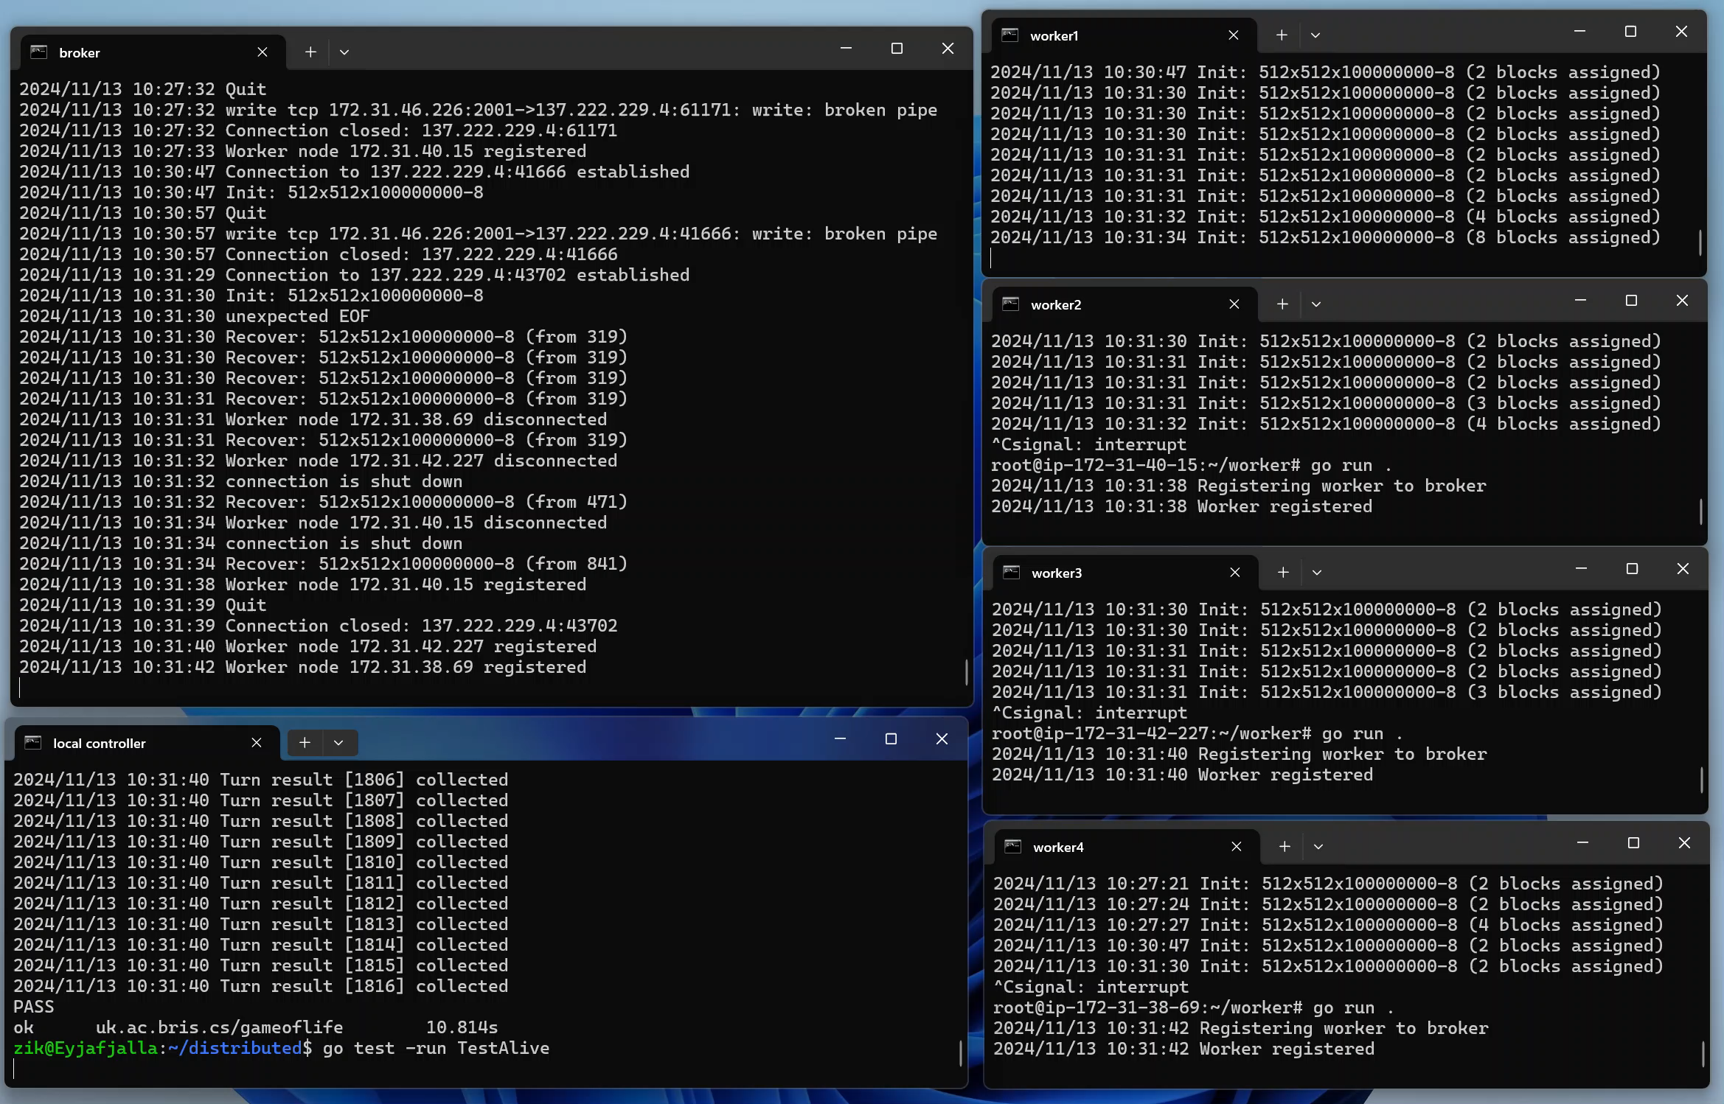
Distributed: Fault Tolerance

Slide 21
Distributed: Benchmarks

Slide 22
Distributed: Benchmarks

